Slide 1

Name: Ejikeme Nwosu Date: 21- 06 – 2022
Notes:
Hi my name is Ejikeme Nwosu, I hope streaming has been treating you guys well, if you don’t mind me asking what sort of content do you guys' stream?

Slide 2
What factors are related to growth on twitch for top streamers
Notes:
I was able to narrow down issue you guys had into 1 question which is <read what is on the slide>

Slide 3
Table of Content
Understanding the data set
Initial assumptions
Analysis Findings
Conclusion
Appendix

Slide 4
Understanding the Data Set
From Kaggle
By user @AyushMishra in 2021
Top 1000 from the past year (2020)
It includes channel names, watch time in minutes, stream time in minutes, active viewer, average viewers, followers gained, viewer gained, partnered and if they produce mature content or not
Notes:
Firstly, I want to explain the data I used to answer this question. It is a data set from Kaggle, I would explain what Kaggle is at the end of the presentation as it is of less importance than the question at hand
<then explain the data and the features>

Slide 5
Initial Assumption
The higher the watch time the higher the follower gain
The higher the stream time the higher the viewer gain
The higher the follower gain the higher the viewer gain
Notes:
When I think of a channel's growth, I think of gaining followers and viewers, if you don’t mind me asking what do you guys assume you could do to bring about growth of your channel in relation to the features
I listed before? Well, I also had my own assumptions <transition to showing them the assumptions you had>

Slide 6
Findings
Notes:
I had to make sure my assumptions were right because I wouldn’t want to just give you guys' recommendations just off what I feel is right

Slide 7
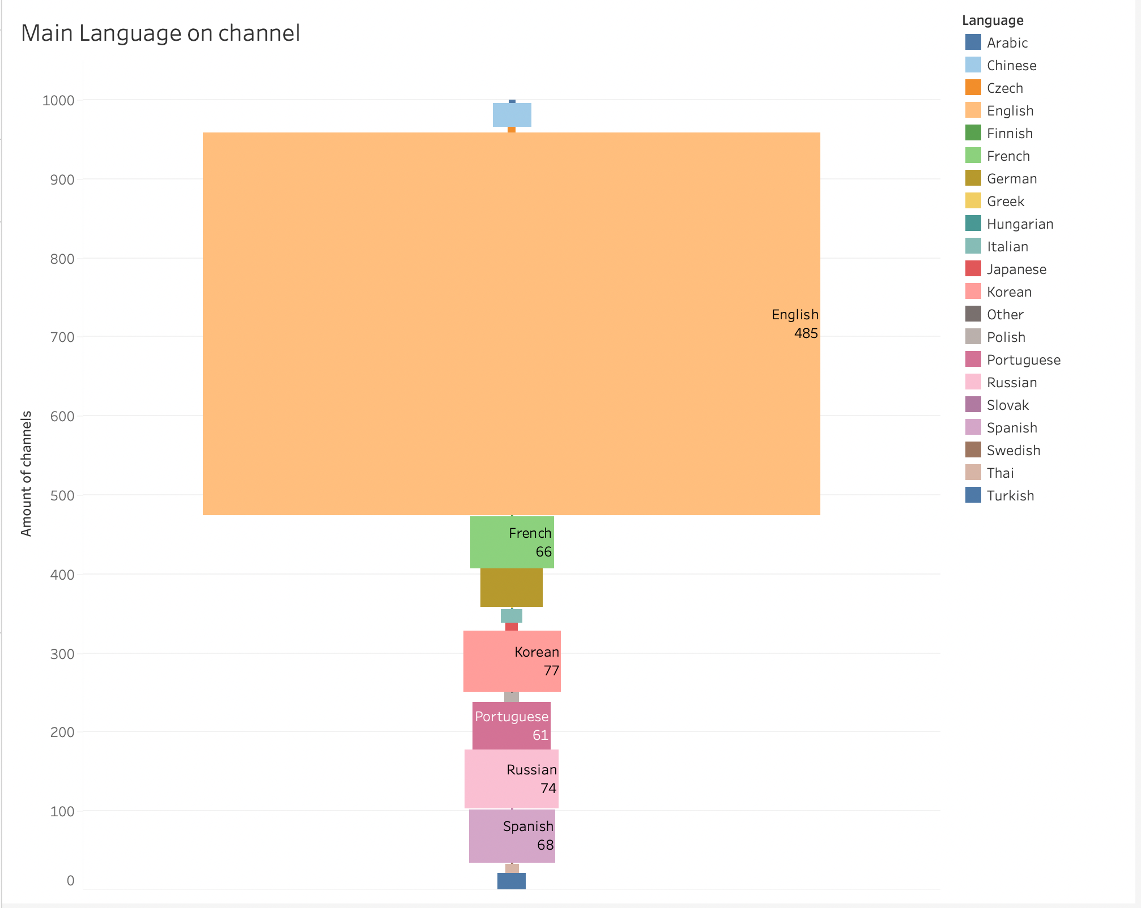
Language
Majority of the channels have English as their main language
48.5%
Notes:
At first, I wanted to check if language had anything to do with growth. Looking at the viz you can clearly tell majority of the channels speak English so going further with any analysis using this feature will be biased because the percentage of English channels is too greatly represented and to have accurate finding all languages would have to be equally represented. But anyway, you guys speak English so you should be good lol

Slide 8
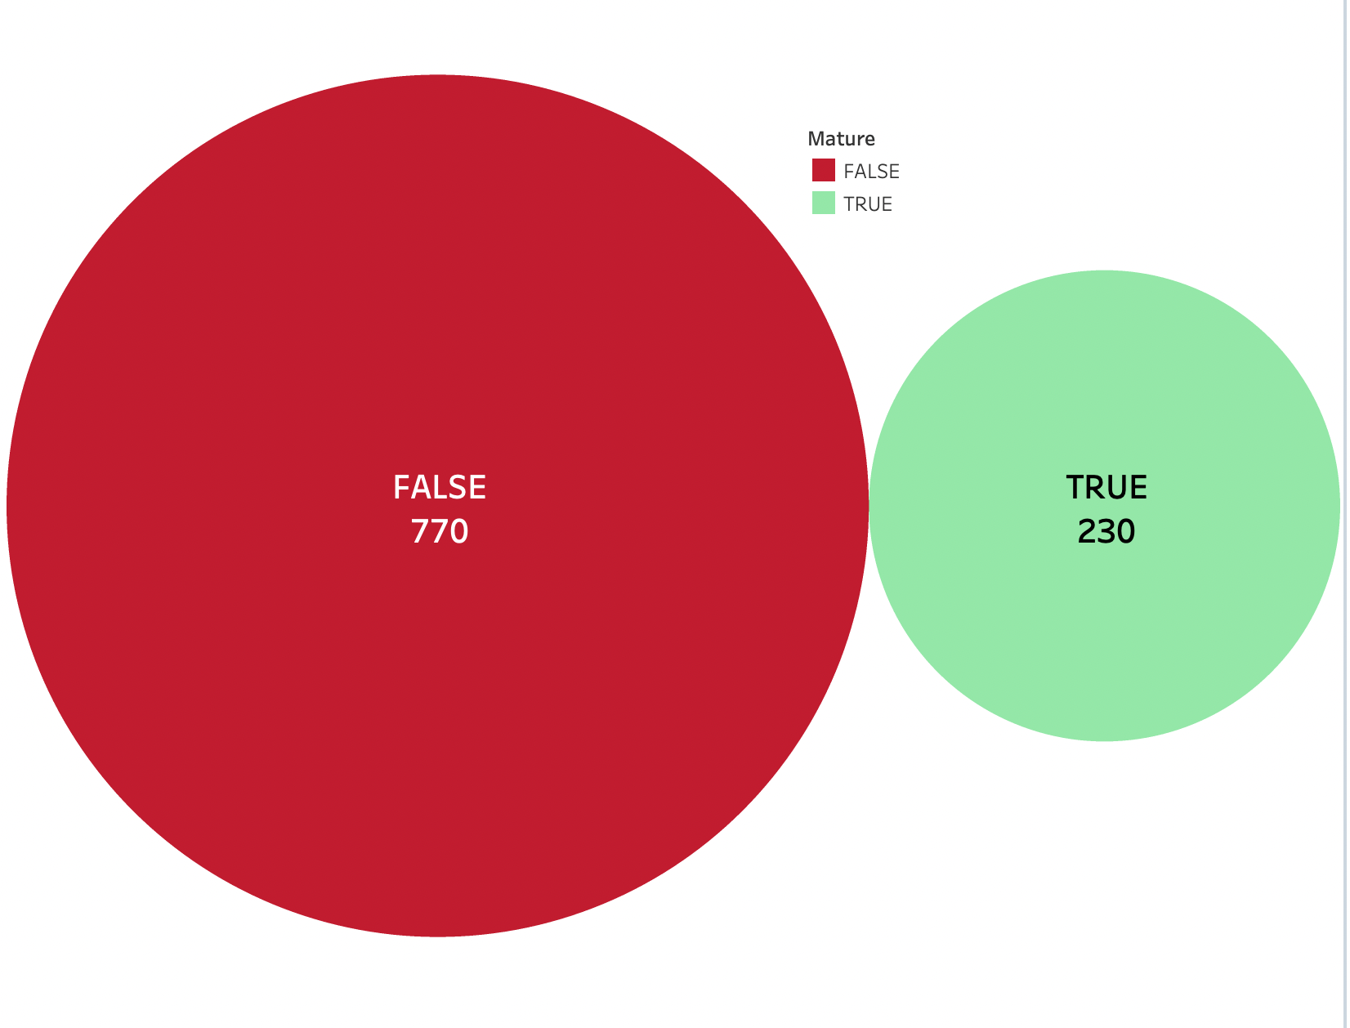
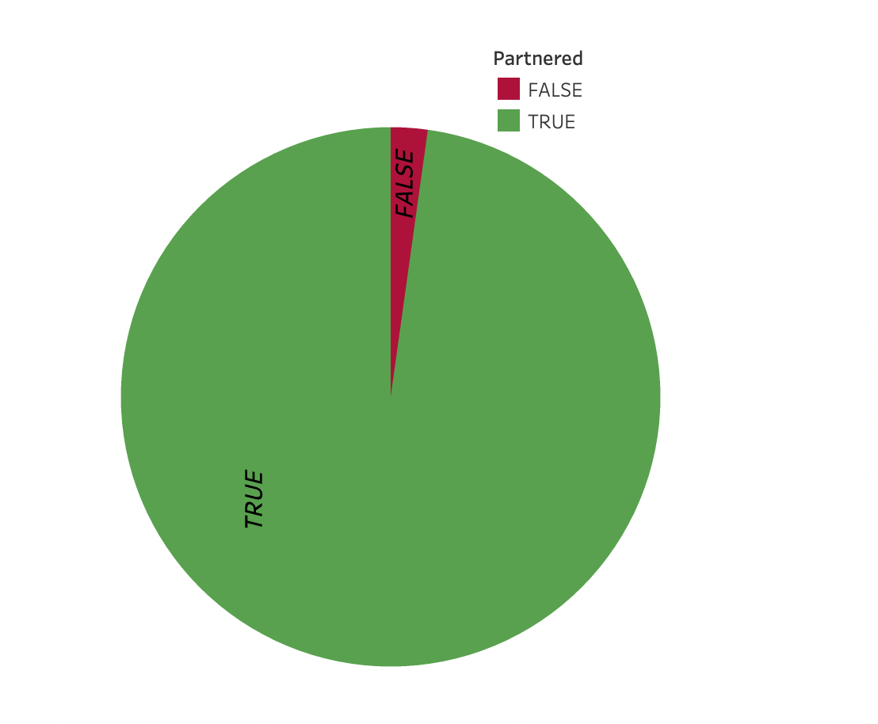
Twitch partner & Mature Content
Majority of the channels are partnered and do not release mature content
97.8%
Notes:
I went further to check if being a twitch partner or having mature content had any thing to do with growth but ran into the same problem of one being more represented than the orther.

Slide 9
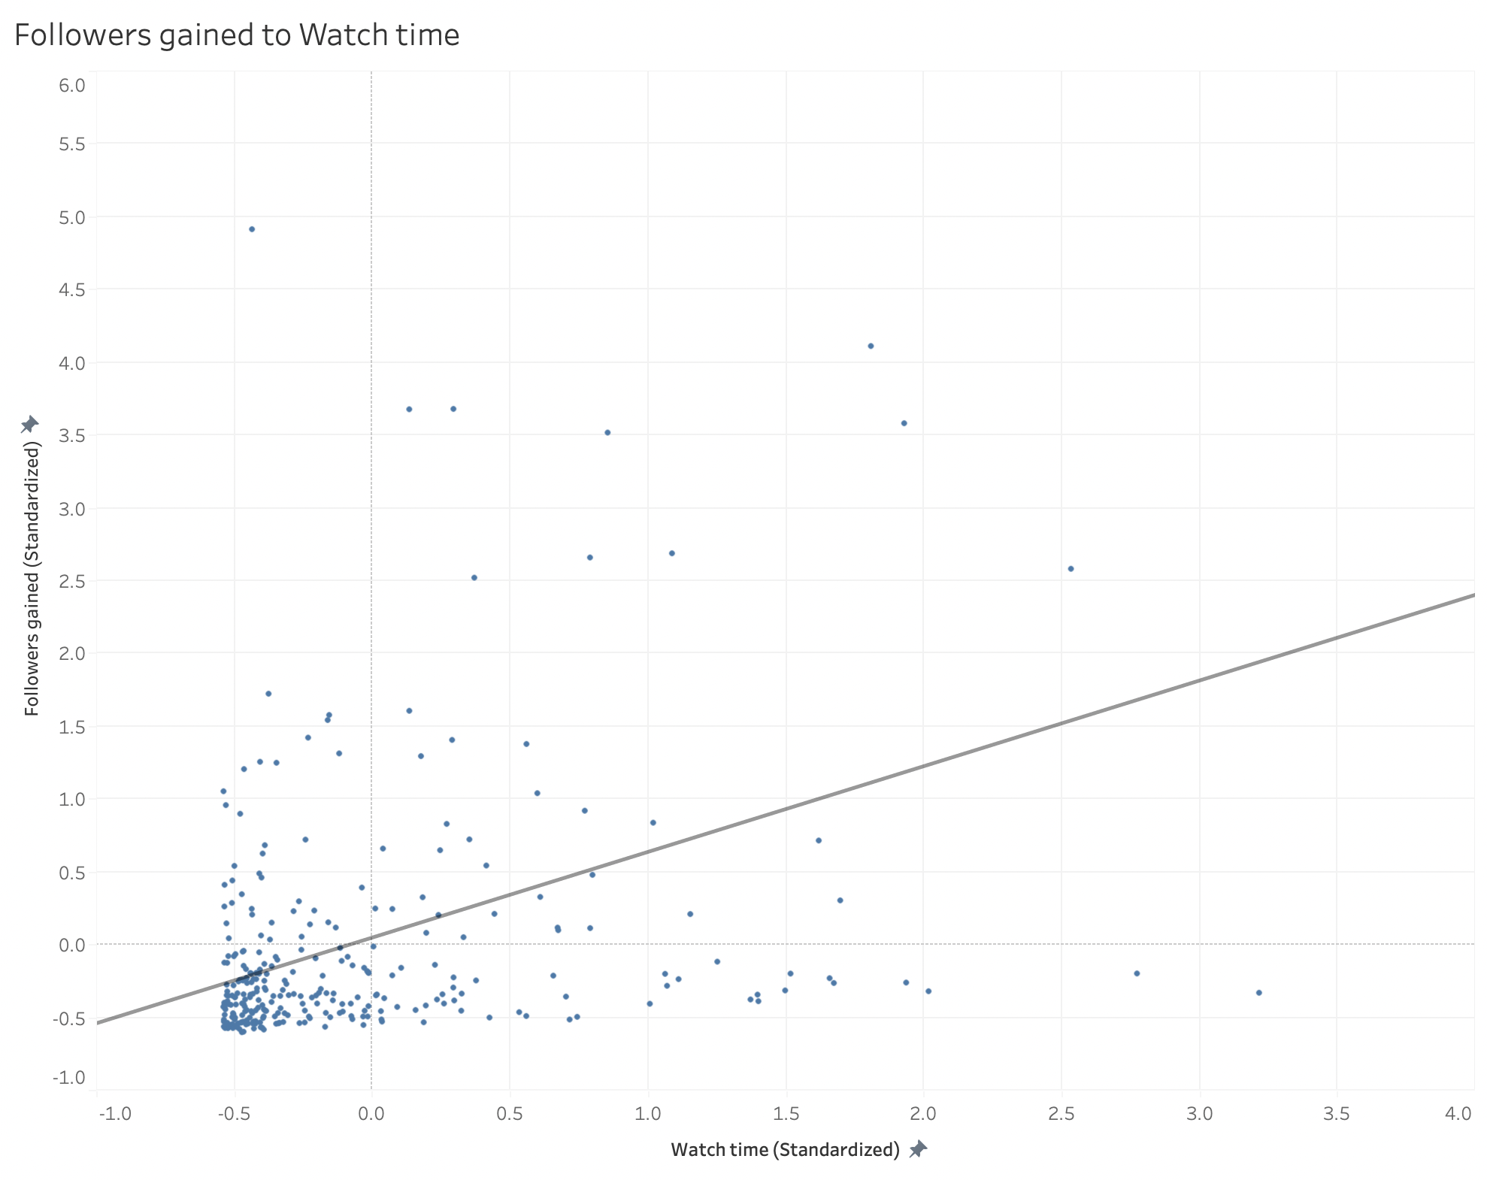
Watch time and Follower gain
r = 0.51
There is a strong relationship between watch time and follower gain
Notes:
At this point things go interesting because I could finally do further analysis. Looking at the graph you can see there is a positive relationship between the two in fact the correlation coefficient is 0.51
Correlation coefficient is a number between +1 and -1 that shows how correlated 2 things are, that is the closer to 1 or -1 the stronger the correlation.

Slide 10
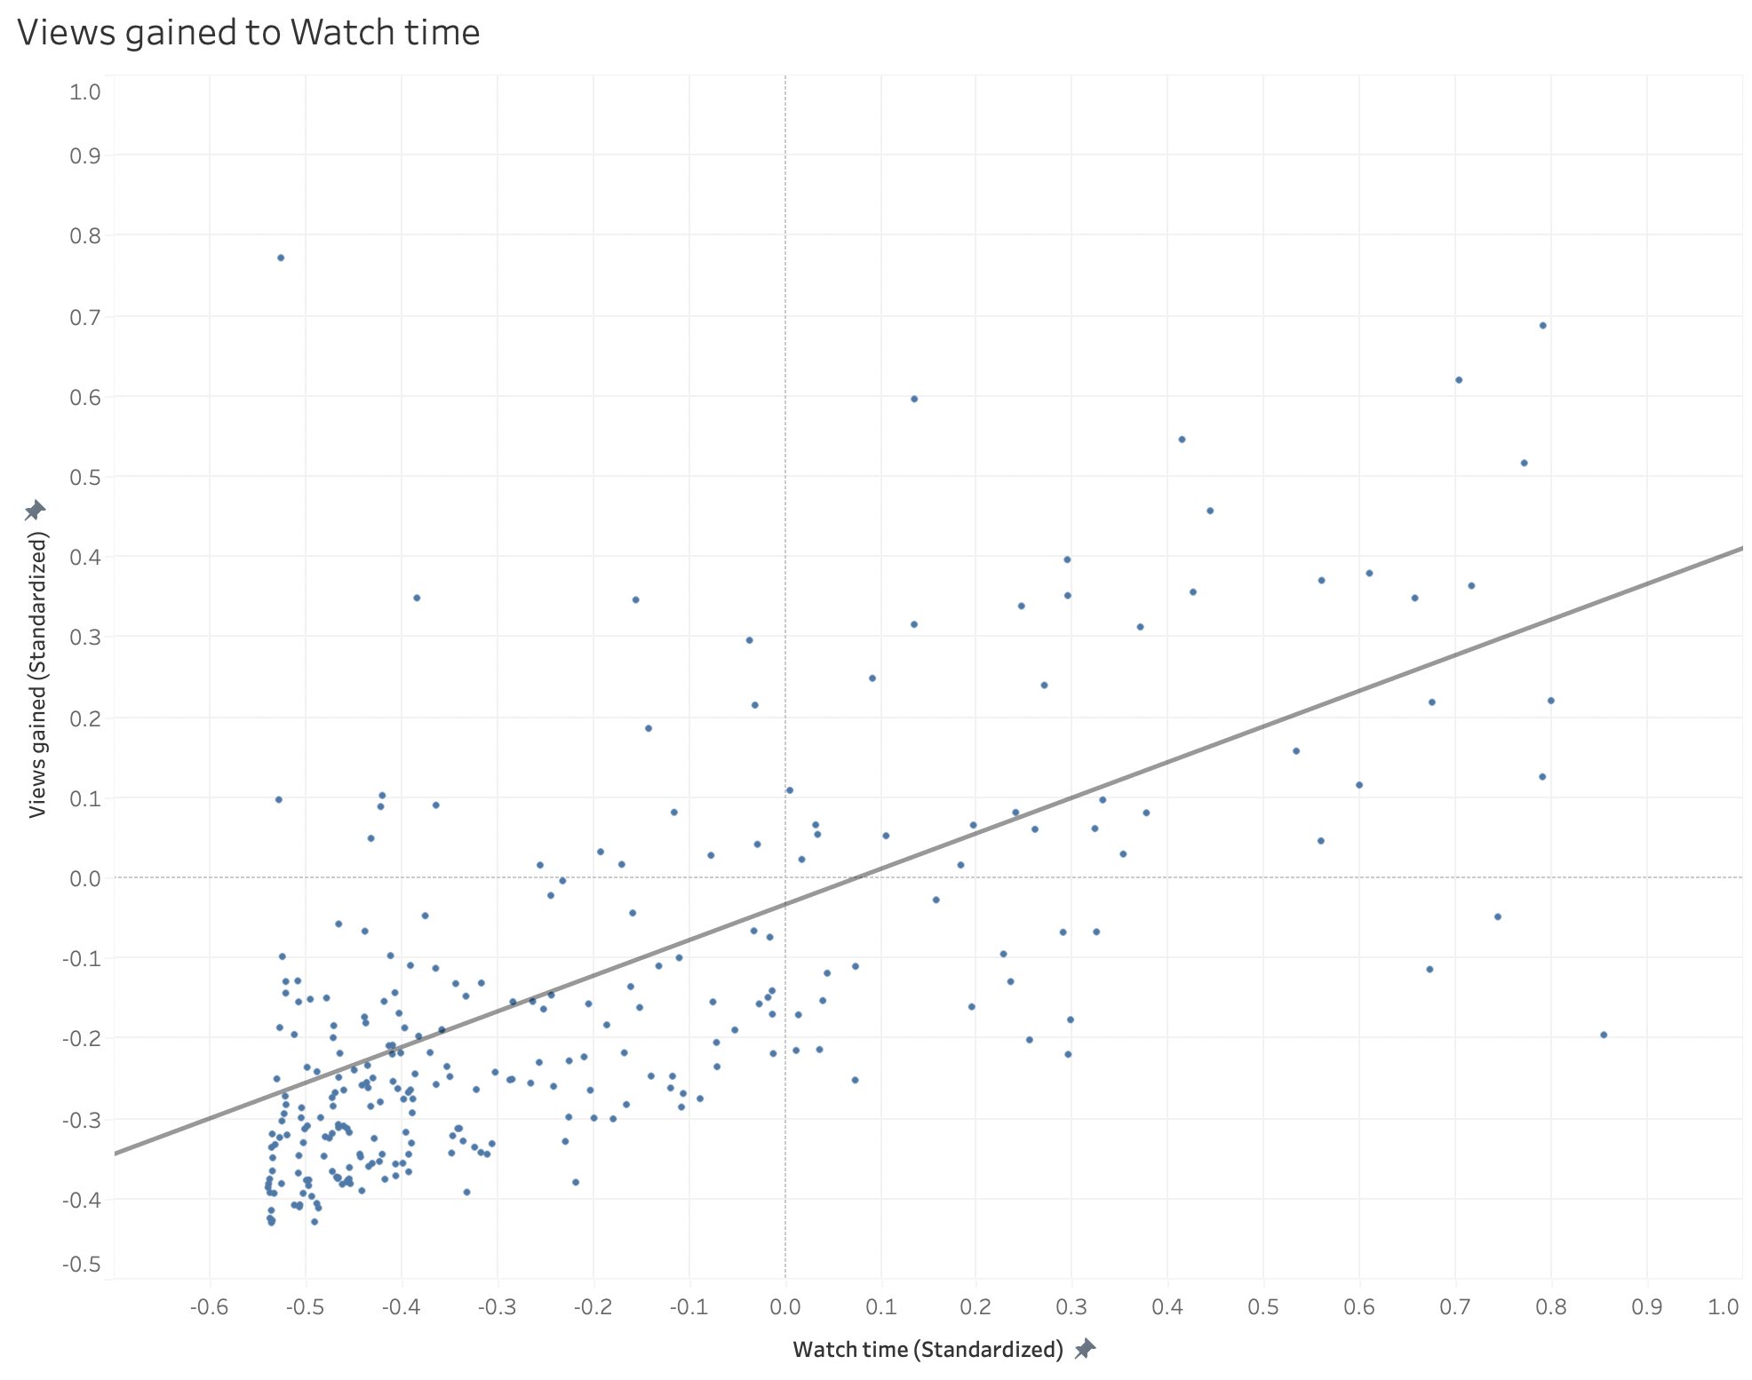
Watch time and viewer gain
r = 0.53
It is also related to the gain in viewers
Notes:
Again, we can see that watch time correlated to the aspects of growth. At this point I felt good because if you remember I already assumed this was going to be the case. Also, I should make it clear that just because one this is correlated to another does not mean that one causes the other, to find this out an experiment would need to take place.

Slide 11
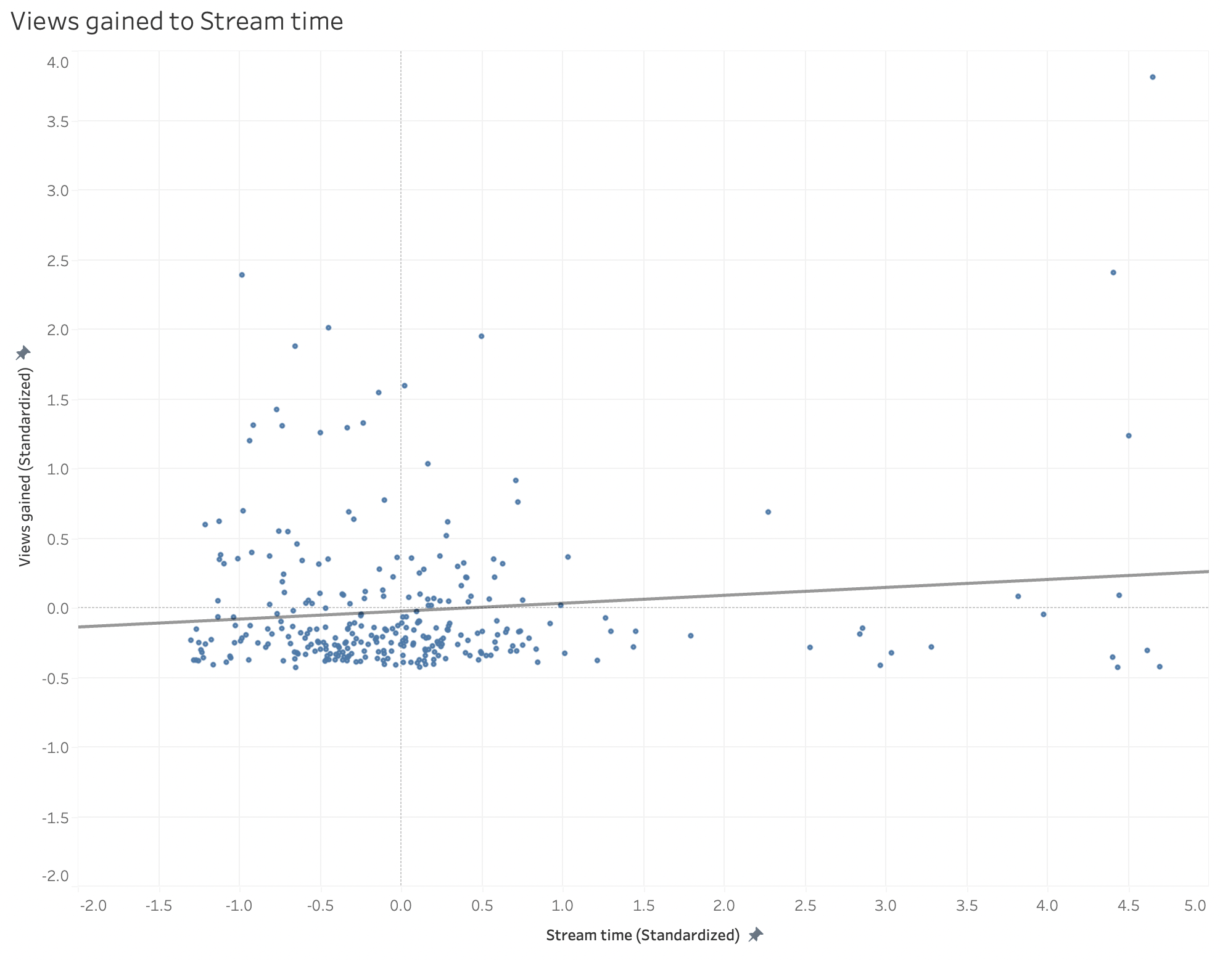
Stream time and Viewer gain
r = 0.06
There is almost no correlation between these two
Notes:
Now this surprised me because I always thought that the more or longer you stream the more viewers you should have but as we can see that is not the case. In fact, there is almost no correlation between the 2 of them so it is not possible for one to cause another. I should also state for there to be causation there must first be correlation.

Slide 12
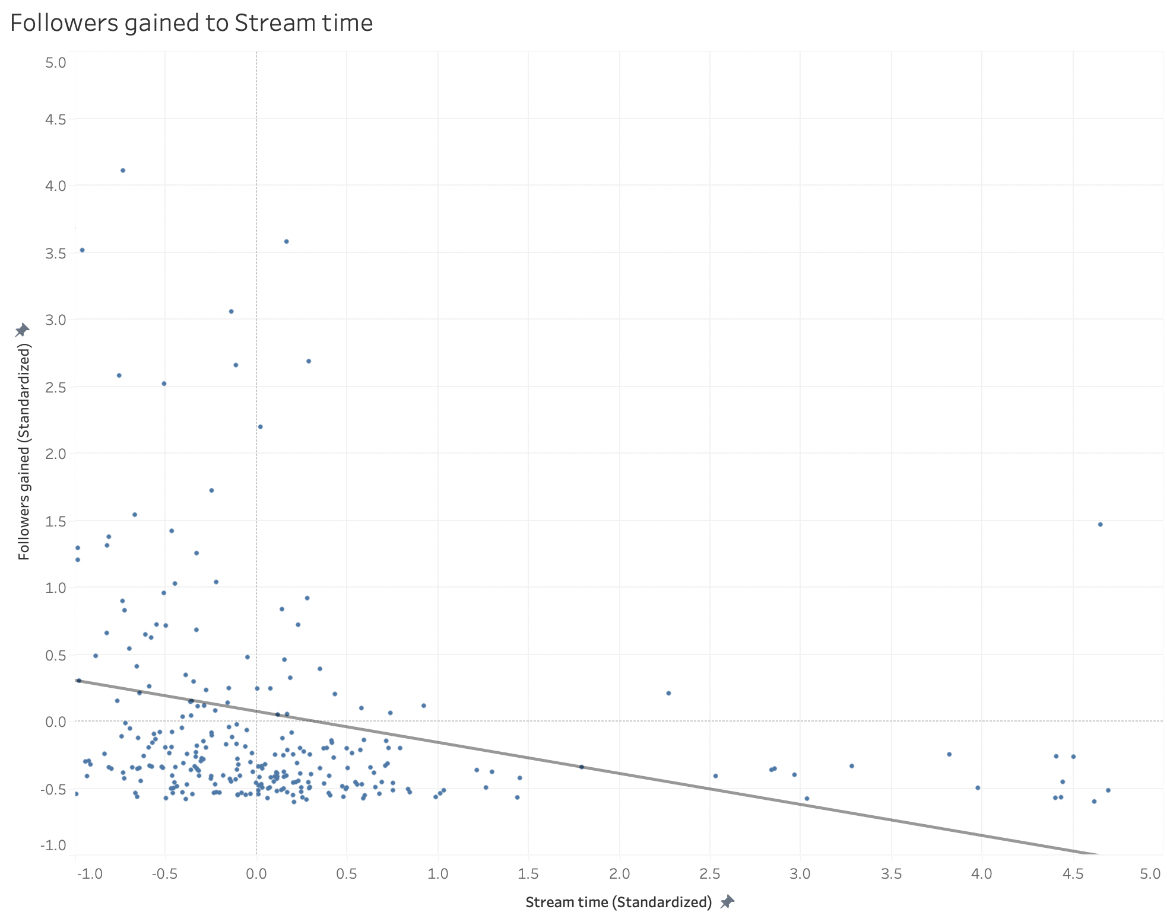
Stream time and Follower Gain
r = -0.16
This is inversely related
Not strong enough relation
Notes:
At this point I couldn’t believe my eyes because although the correlation is not strong it is negative meaning while one goes up the other goes down. I guess the saying the have see you finish is a real thing even when you’re streaming. Because it seems like the longer you stream chances are you’re not gaining as much followers as someone who isn’t.

Slide 13
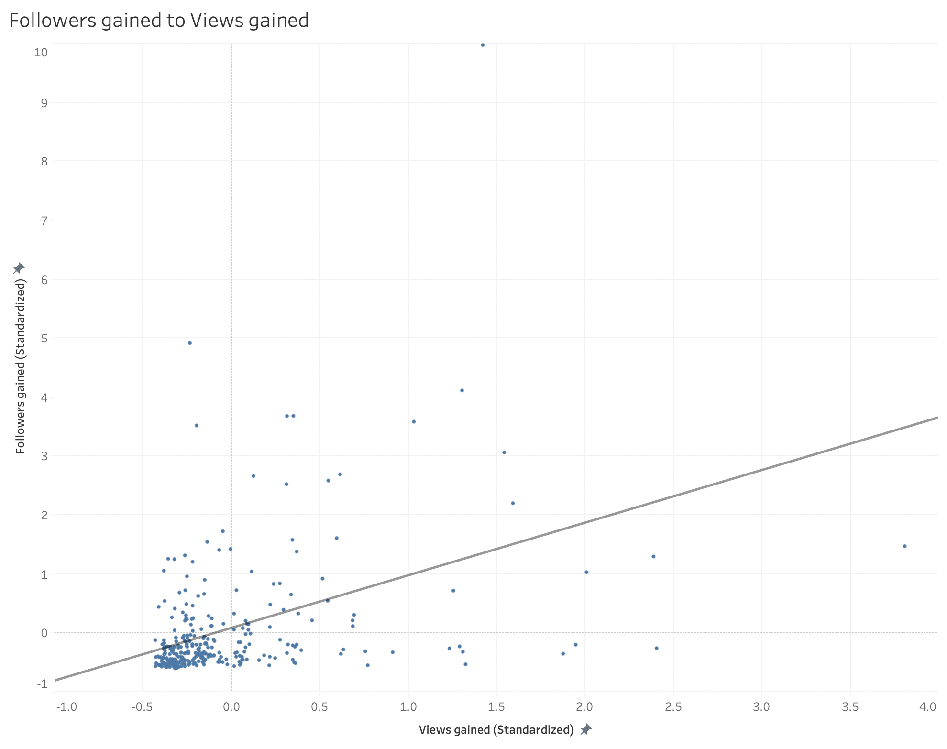
Followers gain to viewer gain
r = 0.24
These to factors, although both define growth are not as correlated
Notes:
I just wanted to see how correlated the two factors I classified as channel growth were and we can see they aren’t as related.

Slide 14
Conclusion

Slide 15
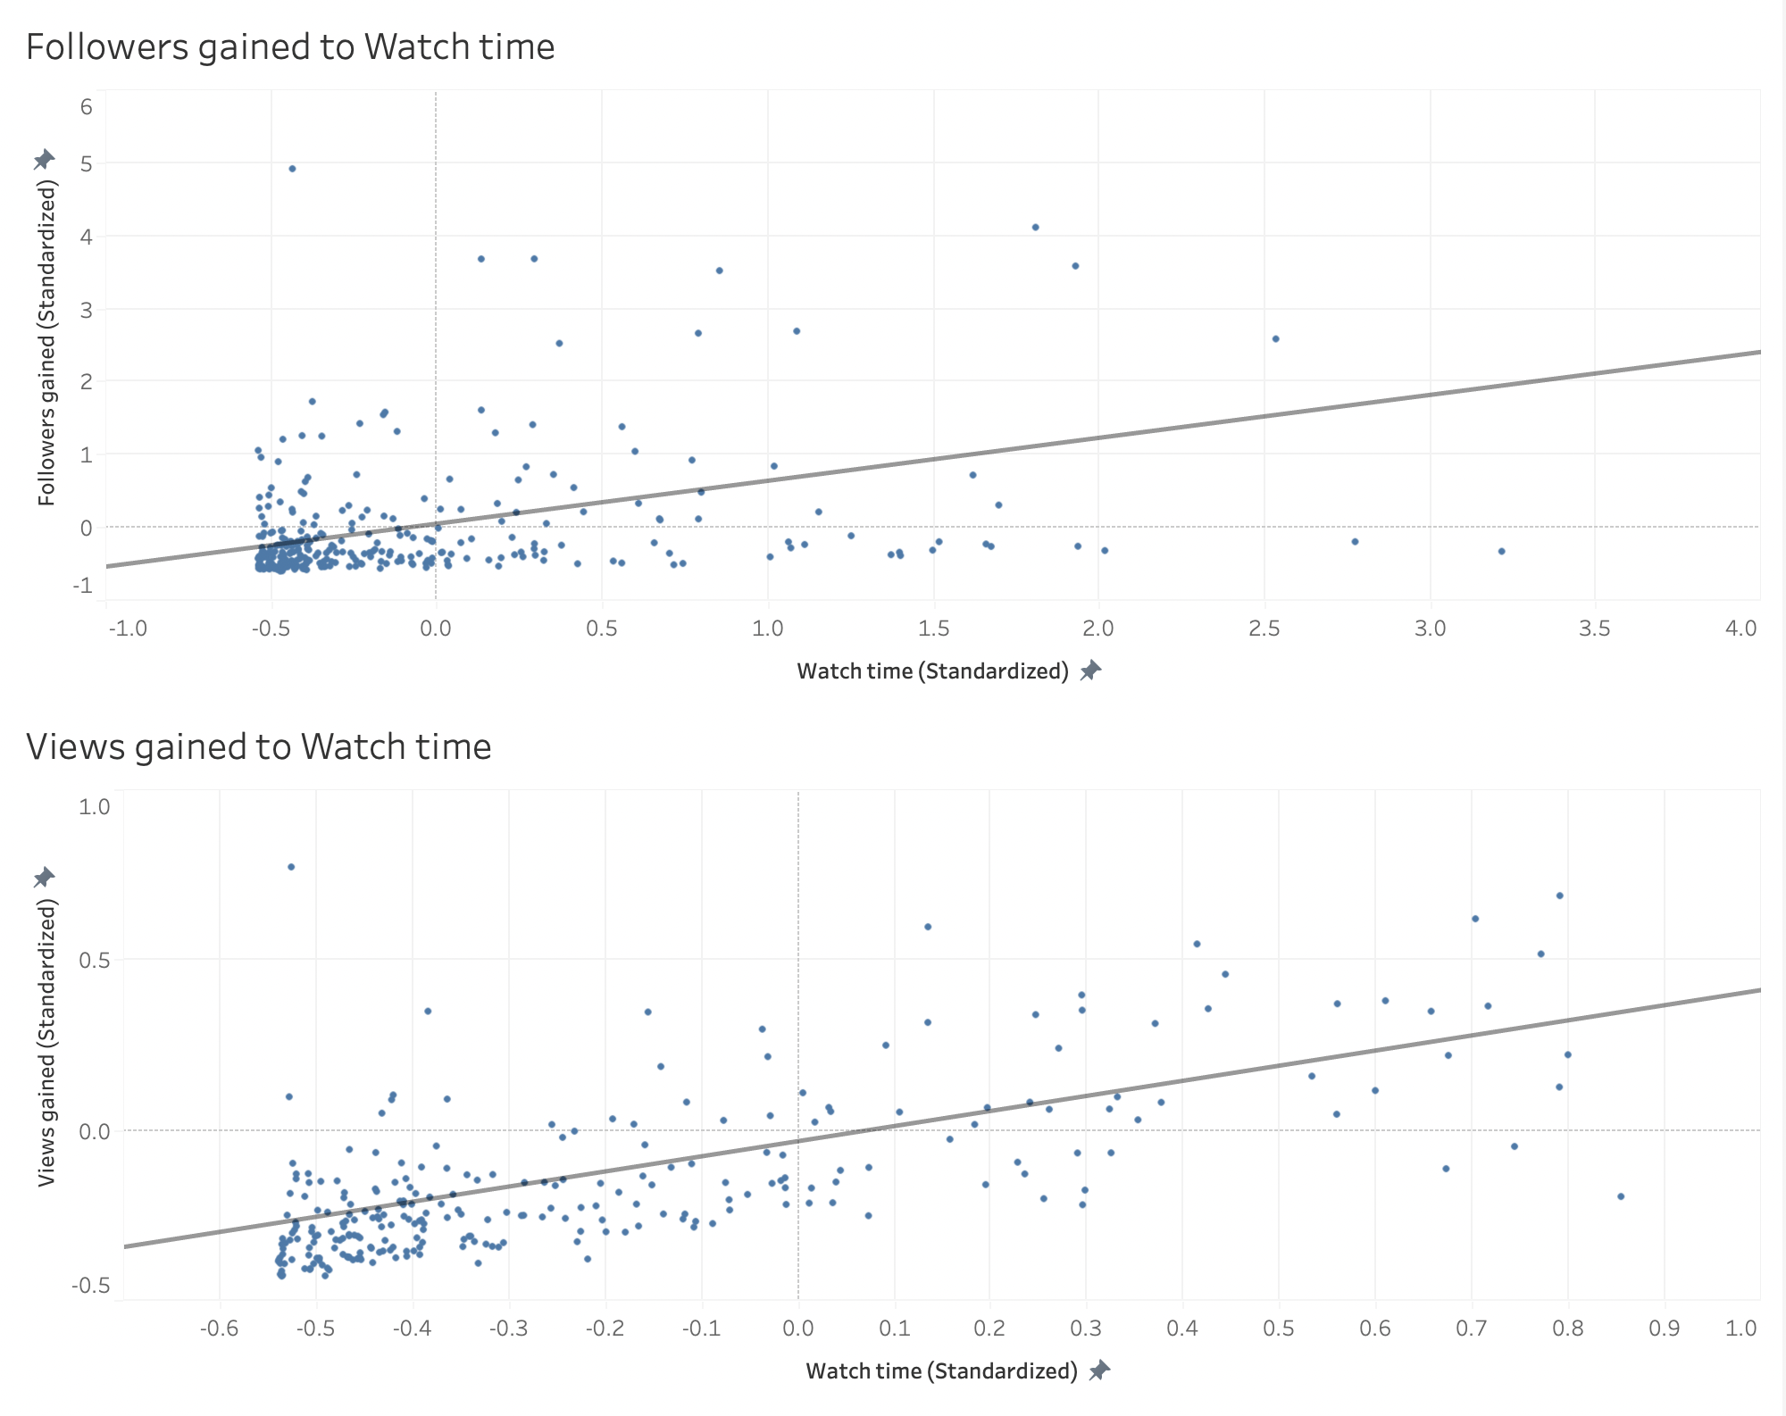
The watch time of a channel is related to the growth of a channel
An increase in the retention of viewers is likely to come with growth in your channel
More followers does not necessarily mean more viewers
Notes:
Watch time is really related to the growth of a channel. This means if you’re keeping your viewer entertained, doesn’t even have to be for long hours chances are this will come with growth in your channel whether you base that on viewers or followers.

Slide 16
Questions ?

Slide 17
Appendix

Slide 18
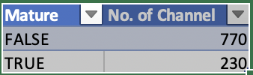
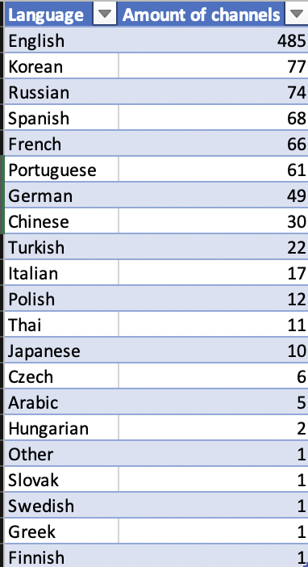
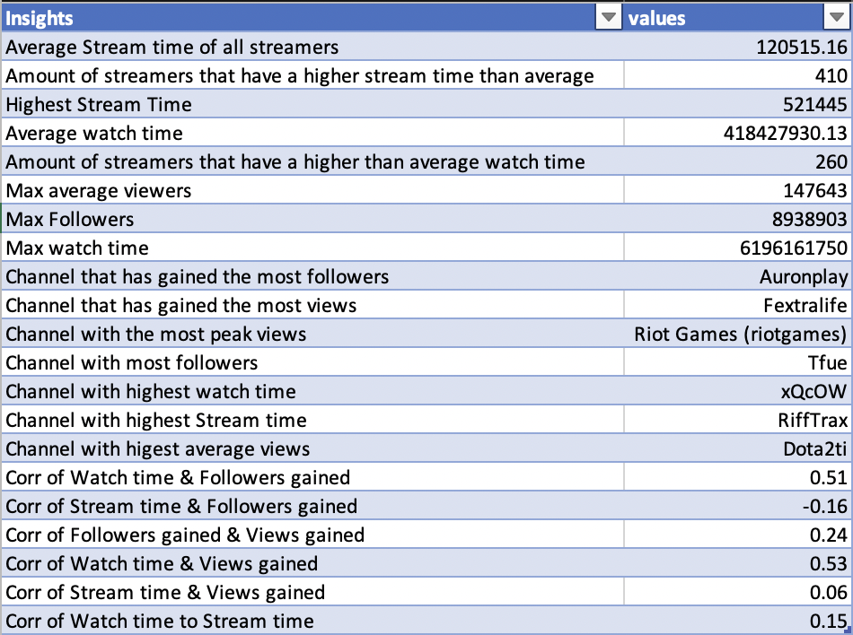
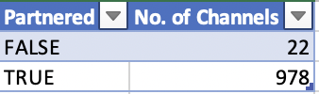
Insights

Slide 19
Tools used for the project
Microsoft Excel: used for cleaning, and EDA
Tableau: Used for data visualization
RStudio: Used to extract a sample of size 300 from the data set to be used in the visualizations

